Slide 1
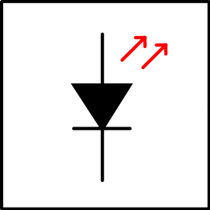
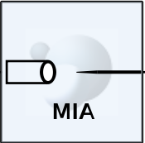
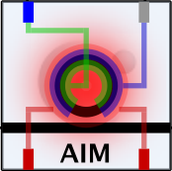
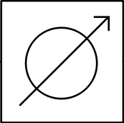
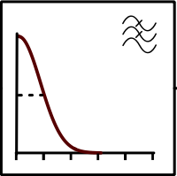

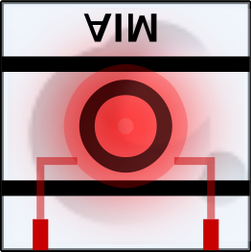
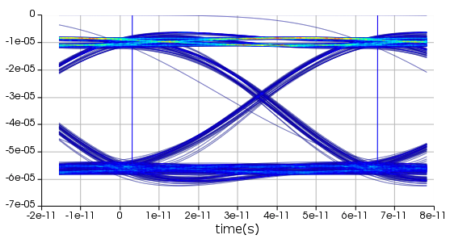
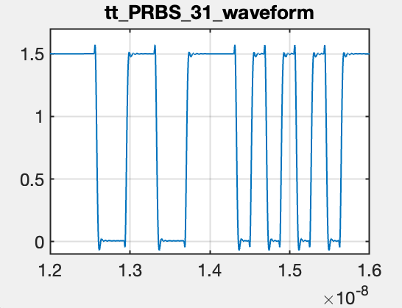
TX
tt_PRBS_31
0dBm Source
Coupler
Microdisk Modulators
Attenuator
DATA_OUT
LPF(12GHz)
Photodiode
Microring Filters
RX
Eye @ DATA_OUT, 0 attenuation
Waveform from EIC
BER result will be available(sweep vs. PD input power; compared to prev. link analysis results
Next: corner case analysis (ff, ss)

